Slide 1


Ariba® Network
Supplier Guide
Get Started

Slide 2
Using This Guide
The purpose of this guide is to help suppliers understand the business processes required by Dragon Oil.
You may navigate this guide by:
Clicking the buttons in the toolbar
Clicking the hyperlinks on the pages – Hyperlinks may be words or shapes within the graphics
Using the bookmark panel to the left
This button will take you back to the previous page
This button will take you to the next step
This button will return you to the beginning of the section, or skip back between sections
The HOME button will return you to the Guide Contents page
If you need additional help, you will find a help button at the bottom of each page that will assist you in finding the appropriate support contact.
Tabs in the lower left corner link out to our Community Support pages. Look for these to answer your most common questions.

Slide 3
SECTION 1: Ariba Network Overview
What is Ariba Network?
Dragon Oil Project Scope
Supplier Value
Supported Documents
Not Supported Documents

Slide 4
SECTION 2: Set Up Your Account
Basic Account Configuration
Enablement Tasks
Advanced Account Configuration
Configuration Requirements
Accept Invitation
Profile Completion
Email Notifications
Enablement Tasks
Purchase Order Routing
Invoice Notifications
Tax Details
Remittances
Customer Relationships
Roles and Users
Enhanced User Account Functionality
Multi-Orgs
Test Accounts

Slide 5
Dragon Oil Specific Account Configuration
VAT ID / TAX ID – select Company Settings in the top right corner, go to Company Profile and select tab Business. In the section Financial Information enter your Vat ID / Tax ID.
Remittance Address – select Company Settings in the top right corner and go to Remittances. In the EFT/Check Remittances section select Create and complete all required fields marked by an asterisk.
Payment Methods – select Company Settings in the top right corner and go to Remittances. In the EFT/Check Remittances section select Create/Edit. In the Payment methods section choose one of the following options: ACH, Check, Credit card or Wire. Complete the details. The Remittance ID will be communicated to you by your buyer.
Test Account Creation (testing is required for integrated and catalog suppliers) – To create a test account, select your name in top right corner and choose “Switch to Test ID.”
Currency – The currency that Ariba Network uses in the service subscription area of your account is controlled by your organization’s location, which you specify in User Account Navigator > My Account > Preferences.

Slide 6
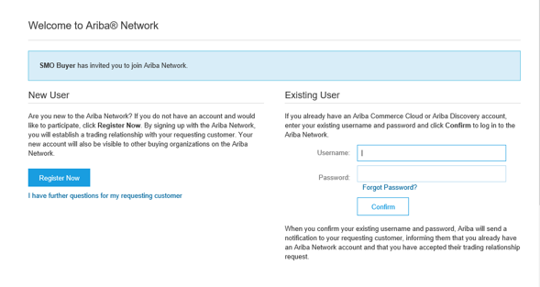
Since your Ariba Account is created
Existing User

Slide 7
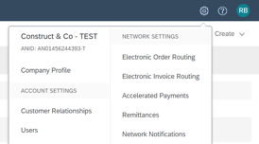
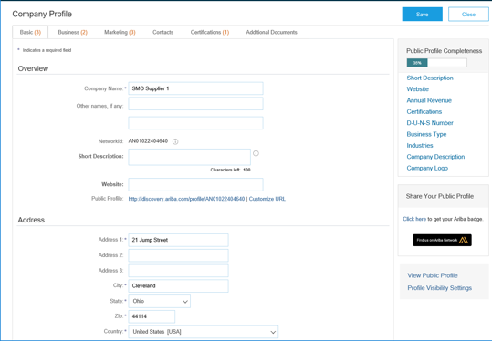
Complete Your Profile
Select Company Profile from the Company Settings dropdown menu.
Complete all suggested fields within the tabs to best represent your company.
Fill the Public Profile Completeness meter to 100% by filling in the information listed below it.
Note: The more complete a profile, the higher the likelihood of increasing business with existing and prospective customers.

Slide 8
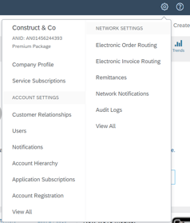
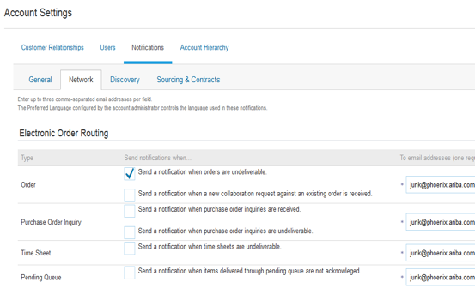
Configure Your Email Notifications
The Network Notifications section indicates which system notifications you would like to receive and allows you to designate which email addresses you would like to send them to.
Click on Notifications under Company Settings.
Network Notifications can be accessed from here as well, or you may switch to the Network tab when in Notifications.
You can enter up to 3 email addresses per notification type. You must separate each address with a comma but include NO spaces between the emails.
2
1
3
Note: If you are out of the office, make sure to include in your auto-reply messages one of the following phrases. This will prevent Ariba Network from failing orders sent to mailboxes responding using an auto-reply feature: Out of office, OOTO, On vacation, on holiday, out of town, away from the office, away until, out of the country, an off site meeting. When Ariba Network detects an auto-reply containing one of these phrases, it indicates that it received the auto-reply in the order history log and does not fail the order.

Slide 9
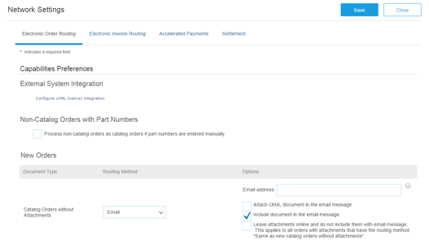
Select Electronic Order Routing Method
Click on the Tasks link to configure your account.
Choose one of the following routing methods:
      Online
      cXML
      EDI
      Email
      Fax
      cXML pending queue (available for Order routing only)
Configure e-mail notifications.
2
3

Slide 10
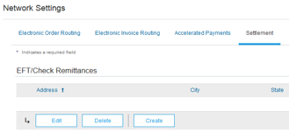
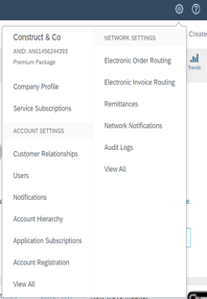
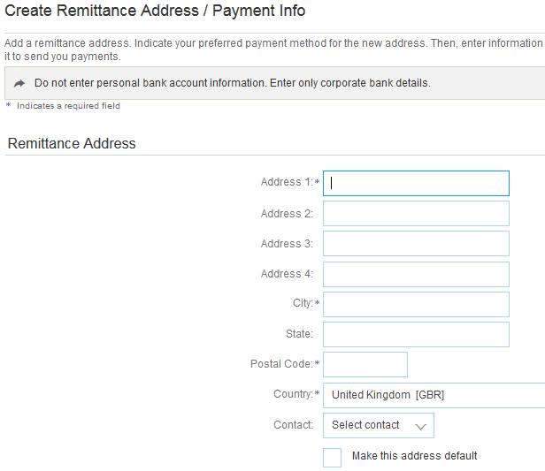
Configure Your Remittance Information
From the Company Settings dropdown menu, select click on Remittances.
Click Create to create new company remittance information, or Edit, if you need to change existing information.
Complete all required fields marked by an asterisk in the EFT/Check Remittances section.
Select one of your Remittance Addresses as a default if you have more than one. If needed, assign Remittance IDs for this address for each of your customers. Clients may ask you to assign IDs to your addresses so they can refer to the addresses uniquely. Each client can assign different IDs.
2
1
3
4

Slide 11
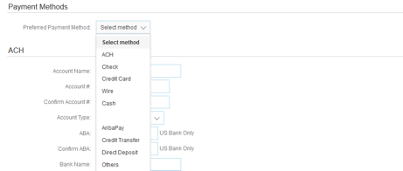
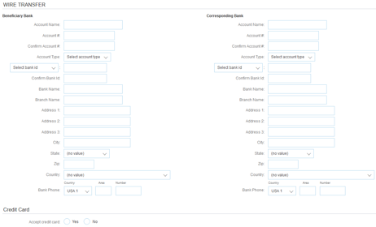
Configure Your Remittance Information
Payment Methods
Select Preferred Payment Method from a drop-down box: Check, Credit card or Wire.
Complete the details for ACH or Wire transfers.
Select if you do or do not accept credit cards and click OK when finished.
Note: This does not change the method of payment from your customer, unless specified.
1
2
2
3

Slide 12
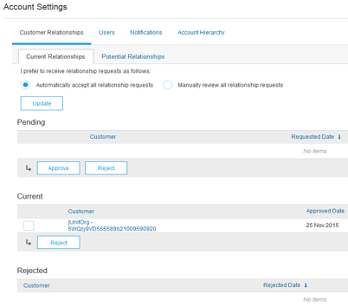

Review Your Relationships
Current and Potential
Click on the Customer Relationships link in the Company Settings menu.
Choose to accept customer relationships either automatically or manually.
In the Pending Section, you can Approve or Reject pending relationship requests. In the Current Section, you can review your current customers’ profiles and information portals. You can also review rejected customers in the Rejected Section.
Find potential customers in Potential Relationships tab.
4
2
1
1
3

Slide 13
Set Up User Accounts
Roles and Permission Details
Administrator
There can only be one administrator per ANID
Automatically linked to the username and login entered during registration
Responsible for account set-up/configuration and management
Primary point of contact for users with questions or problems
Creates users and assigns roles/permissions to users of the account
User
Up to 250 user accounts can exist per ANID
Can have different roles/permissions, which correspond to the user’s actual job responsibilities
Can access all or only specific customers assigned by Administrator

Slide 14
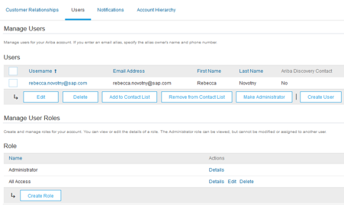
Set Up User Accounts
Create Roles and Users (Administrator Only)
Click on the Users tab on the
Company Settings menu.
The Users page will load.
Click on the Create Role button in the Manage Roles section and type in the Name and a Description for the Role.
Add Permissions to the Role
that correspond to the user’s
actual job responsibilities by
checking the proper boxes and
click save to create the role.
4
5
1
3
2
To Create a User Click on Create User button and add all relevant information about the user including name and contact info.
Select a role in the Role Assignment section and Click on Done. You can add up to 250 users to your Ariba Network account.
1

Slide 15
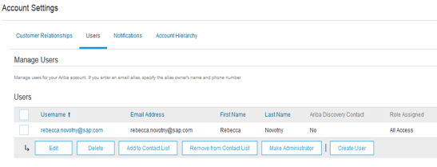
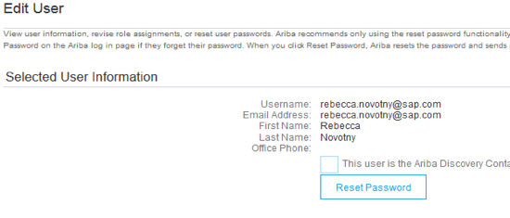
Set Up User Accounts
Modifying User Accounts (Administrator Only)
Click on the Users tab.
Click on Edit for the selected user.
Click on the Reset Password Button to reset the password of the user.
Other options:
Delete User
Add to Contact List
Remove from Contact List
Make Administrator
1
2
4
3

Slide 16
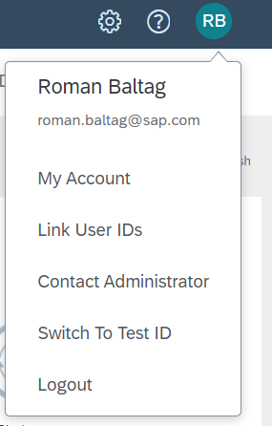
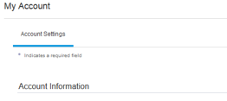
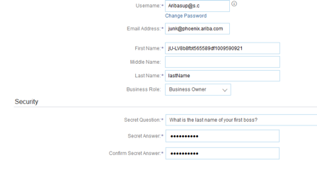
Enhanced User Account Functionality
Click on your name in top right corner, to access the User Account Navigator. It enables you to:
Quickly access your personal user account information and settings
Link your multiple user accounts
Switch to your test account
1
2
Note: After your multiple user accounts are
linked, the User Account Navigator displays
the multiple accounts.
Click on My Account to view your user
settings.
Click Complete or update all required fields
marked by an asterisk. Note: If you change
username or password, remember to use it
at your next login.
Hide personal information if necessary by
checking the box in the Contact Information
Preferences section.
3
4

Slide 17
Link Accounts Via an Account Hierarchy
Linkage between individual accounts for account management purposes
    The administrator of the Parent account can log into the child account and take the following actions:
    Change settings on the child account and complete the company profile
    Publish catalogs
    Check the status of payment for the Ariba invoice and pay the invoice
    Upgrade to a higher Subscription package
    The administrator of the Parent account cannot take following actions:
    View buyers on the Child account
    Create any documents (PO confirmations, Ship Notices, Invoices)
    Run Reports

Slide 18
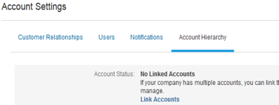
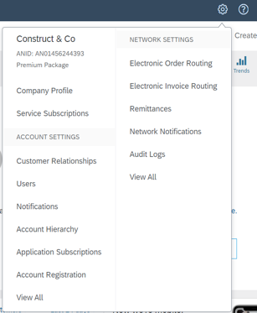
Create an Account Hierarchy
From the Company Settings menu, click Account Hierarchy.
To add child accounts click on Link Accounts.
The Network will detect if there is an existing account with corresponding information.
On the next page either log in as an Administrator or send a request through an online form as a Not Administrator.
Once the request is confirmed by a child account administrator, the name of the linked account is displayed on the Account Hierarchy page.
2
1

Slide 19
SECTION 3: Purchase Order Management
View Purchase Orders
Purchase Order Detail
Create PDF of PO

Slide 20
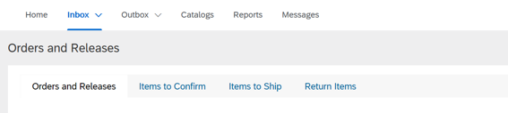
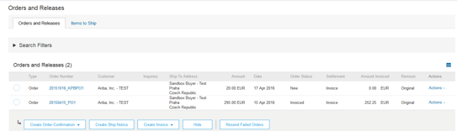
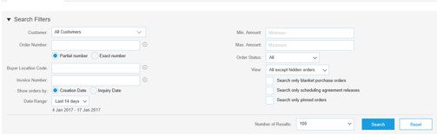
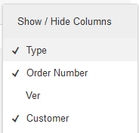
Manage POs
View Purchase Orders
Click on Inbox tab to manage your Purchase Orders.
Inbox is presented as a list of the Purchase Orders received by Dragon Oil.
Click the link on the Order Number column to view the purchase order details.
Search filters allows you to search using multiple criteria.
Click the arrow next to Search Filters to display the query fields. Enter your criteria and click Search.
1
4
3
6
Toggle the Table Options Menu to view ways of organizing your Inbox.
5
6
Can’t Find Your PO?

Slide 21

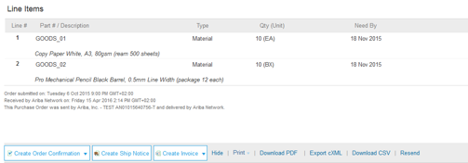
Manage POs
Purchase Order Detail
View the details of your order.
The order header includes the order date and information about the buying organization and supplier.
Note: You can always Resend a PO which was not sent to your email address, cXML or EDI properly clicking Resend button.
Additional options: Export cXML to save a copy of the cXML source information Order History for diagnosing problems and for auditing total value.
1
2
Line Items section describes the ordered items. Each line describes a quantity of items Dragon Oil wants to purchase. Set the status of each line item by sending order confirmations clicking Create Order Confirmation. The sub-total is located at the bottom of the purchase order.

Slide 22
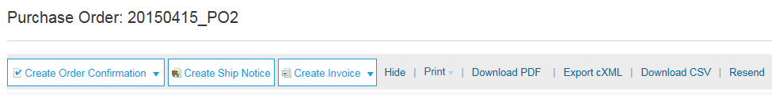
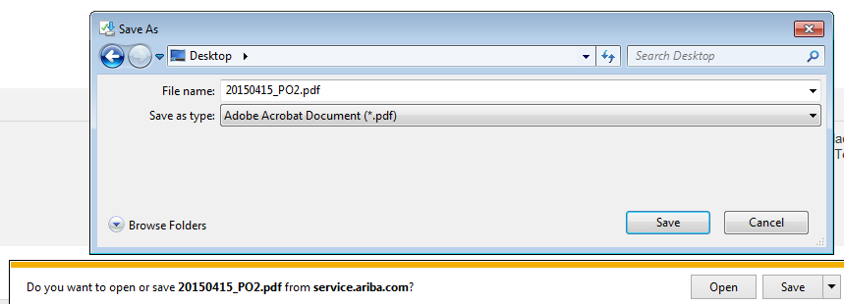
Manage POs
Create PDF of PO
Select “Download PDF” as shown.
Note: If the document exceeds 1000 lines or is larger than 1MB size, details are not shown in the UI. Therefore the detail is not included in the PDF generated.
1

Slide 23
Dragon Oil Invoice Requirements

Slide 24

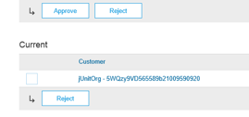
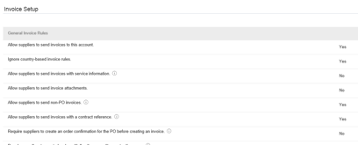
Review Dragon Oil Invoice Rules
These rules determine what you can enter when you create invoices.
Login to your Ariba Network account via supplier.ariba.com
Select the Company Settings dropdown menu and under Account Settings, click Customer Relationships.
A list of your Customers is displayed. Click the name of your customer (Dragon Oil).
Scroll down to the Invoice Setup section and view the General Invoice Rules.
If Dragon Oil enabled Country-Based Invoice Rules then you will be able to choose your Country in Originating Country of Invoice from the drop down menu.
Click Done when finished.
2
2
3
4

Slide 25
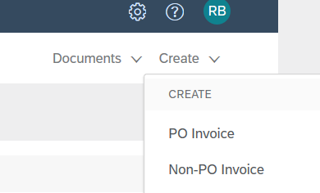
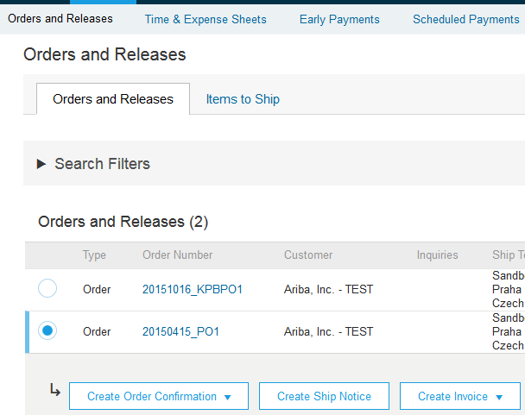
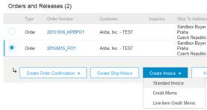
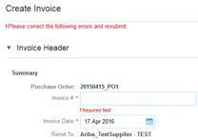
Invoice via PO Flip
To create a PO-Flip invoice (or an invoice derived from a PO that you received via Ariba Network):
From the home screen within your Ariba Network account, select the Create dropdown menu and select PO Invoice.
For PO Invoice select a PO number.
Click on the Create Invoice button and then choose Standard Invoice.
Invoice is automatically pre-populated with the PO data. Complete all fields marked with an asterisk and add tax as applicable. Review your invoice for accuracy on the Review page. If no changes are needed, click Submit to send the invoice to Dragon Oil.
1
2
3
4
Can’t Find Your PO?

Slide 26
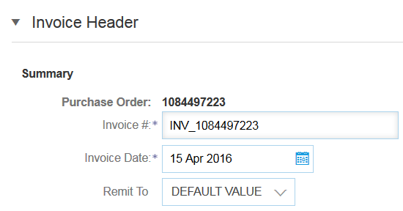


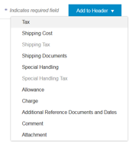
Invoice via PO Flip
Header
Invoice is automatically pre-populated with the PO data. Complete all fields marked with an asterisk and add tax as applicable.
Enter an Invoice # which is your unique number for invoice identification. The Invoice Date will auto-populate.
Select Remit-To address from the drop down box if you have entered more than one.
Tax and Shipping can be entered at either the Header or Line level by selecting the appropriate radio button.
You can also add some additional information to the Header of the invoice such as: Special Handling, Payment Term, Comment, Attachment, Shipping Documents.
Scroll down to the Line items section to select the line items being invoiced.
Note: Support of additional Reference Documents & Dates is applicable for CSC customers only; Attachment file size should not exceed 40MB.
1
2
3
3
4
4

Slide 27

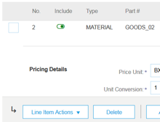

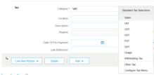

Invoice via PO Flip
Line Items
Line Items section shows the line items from the Purchase Order.
Review or update Quantity for each line item you are invoicing.
Click on the line item’s Green slider to exclude it from the invoice, if line item should not be invoiced OR click the check box on the left of the item and click Delete to remove the line item from the invoice. You can generate another invoice later to bill for that item.
Select the line item to which tax is to be applied using the Line Item # checkbox. To apply the same tax to multiple line items select those line items to be taxed at the desired rate.
To configure additional Tax Options within the Tax Category tool, use the Configure Tax Menu option.
Check Tax Category and use the drop down to select from the displayed options. Click Add to Included Lines.
1
2
3
4
5

Slide 28
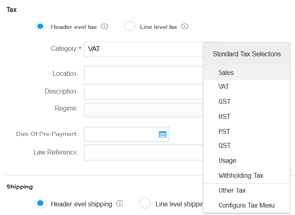



Invoice via PO Flip
Additional Tax Options & Line Item Shipping
To configure additional tax options click Configure Tax Menu under the Tax Category drop down. Create new tax categories and as needed.
Select the Line Item to apply different tax rates to each line item.
Click Line Item Actions > Add > Tax.
Upon refresh, the Tax fields will display
for each selected line item.
Click Remove to remove a tax line item, if not necessary.
Select Category within each line item, then either populate the rate (%) or tax amount and click update.
Enter shipping cost to the applicable line items if line level shipping has been selected.
1
3
2
4
5

Slide 29
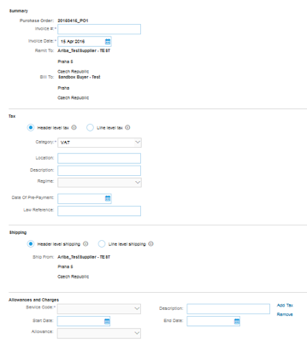
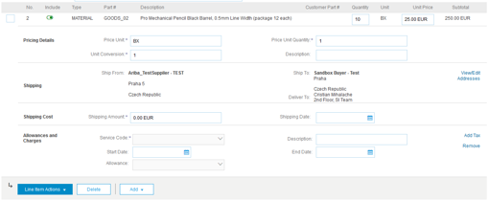
Review Invoice Allowances and Charges
If Allowances and Charges are included in the PO, these will convert to the Invoice at either Invoice Header or Line Item Level based on where the information is on PO:
Header Allowance and Charges
Line level Allowance and Charges
2
1

Slide 30


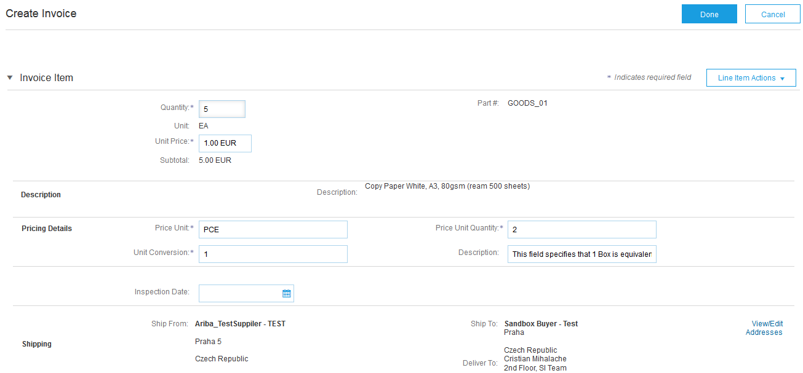
Invoice via PO Flip
Detail Line Items
Additional information can be viewed at the Line Item Level by editing a Line Item.
6
6

Slide 31
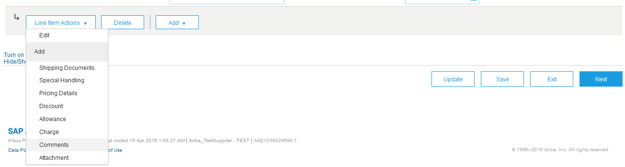
Invoice via PO Flip
Line Item Comments
To add comments at the line items select Line Items, then click at Line Item Actions >Add > Comments.
Upon refresh or Update, the Comments field will display. Enter applicable Comments in this field.
Click Next.
3
1
2
Having Problems?

Slide 32
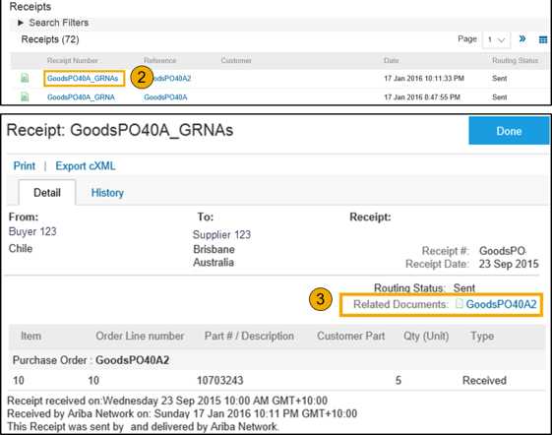
Invoice via PO Flip
Against Goods Receipt
You are required to include only received quantities on invoices.
Click the INBOX tab.
Select the Purchase Order you wish to invoice against.
Select the item(s) from the Receipt List that you would like to invoice.
The invoice is now pre-populated with the items within the Goods Receipt. You now have the ability to select the items to include and/or modify the Quantities on the invoice.

Slide 33
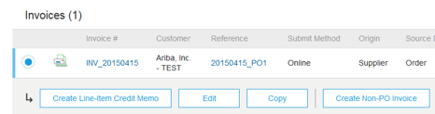
Copy an Existing Invoice
To copy an existing invoice in order to create a new invoice:
Select the OUTBOX Tab.
Either Select the radio button for the invoice you want to copy, and click Copy. OR Open the invoice you want to copy.
On the Detail tab, click Copy This Invoice.
Enter an new invoice number.
For VAT lines, make sure the date of supply at the line level is correct.
Edit the other fields as necessary.
Click Next, review the invoice, and save or submit it.
2

Slide 34
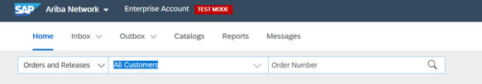

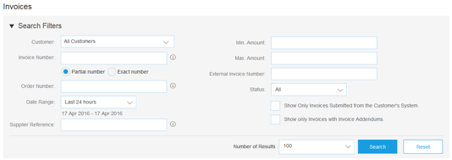
Search for Invoice
(Quick & Refined)
Quick Search:
From the Home Tab, Select Invoices in the Document type to search.
Select Dragon Oil from Customer Drop down menu.
Enter Document # , if known. Select Date Range, up to 90 days for Invoices and Click Search.
Refined Search: Allows a refined search of Invoices within up to 90 last days.
Search Filters from Outbox (Invoices).
Enter the criteria to build the desired search filter.
Click Search.
1
2
3
4
5
6

Slide 35
Check Invoice Status
Routing Status To Your Customer
Check Status:
If you configured your Invoice Notifications as noted earlier in this presentation, you will receive emails regarding invoice status.
You can also check invoice status from the Outbox by selecting the invoice link.
Routing Status
Reflects the status of the transmission of the invoice to Dragon Oil via the Ariba Network.
Obsoleted – You canceled the invoice
Failed – Invoice failed Dragon Oil invoicing rules. Dragon Oil will not receive this invoice
Queued – Ariba Network received the invoice but has not processed it
Sent – Ariba Network sent the invoice to a queue. The invoice is awaiting pickup by the customer
Acknowledged – Dragon Oil invoicing application has acknowledged the receipt of the invoice

Slide 36
Check Invoice Status
Review Invoice Status With Your Customer
Invoice Status
Reflects the status of Dragon Oil’s action on the Invoice.
Sent – The invoice is sent to the Dragon Oil but they have not yet verified the invoice against purchase orders and receipts
Cancelled – Dragon Oil approved the invoice cancellation
Paid – Dragon Oil paid the invoice / in the process of issuing payment. Only if Dragon Oil uses invoices to trigger payment.
Approved – Dragon Oil has verified the invoice against the purchase orders or contracts and receipts and approved if for payment
Rejected – Dragon Oil has rejected the invoice or the invoice failed validation by Ariba Network. If Dragon Oil accepts invoice or approves it for payment, invoice status updated to Sent (invoice accepted) or Approved (invoice approved for payment)
Failed – Ariba Network experienced a problem routing the invoice

Slide 37
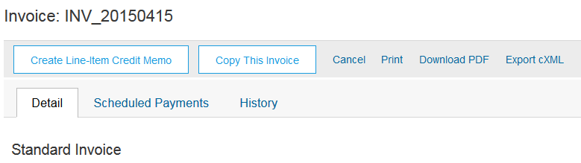
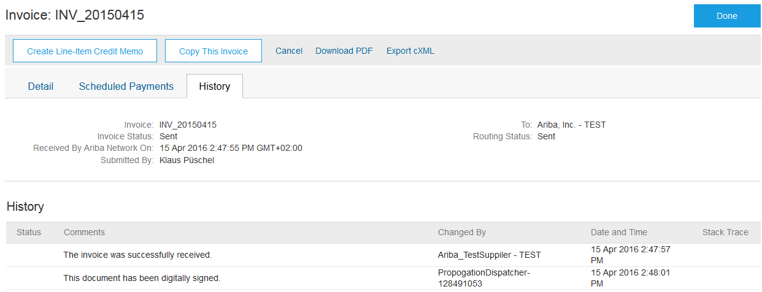
Review Invoice History
Check Status Comments
Access any invoice:
Click on the History tab to view status details and invoice history.
History and status comments for the invoice are displayed.
Transaction history can be used in problem determination for failed or rejected transactions.
When you are done reviewing the history, click Done.
1
4
2

Slide 38
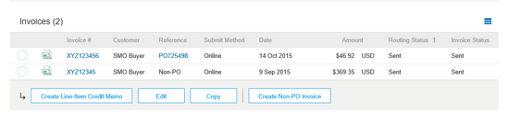
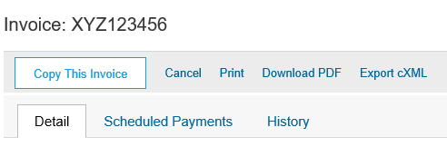

Modify an Existing Invoice
Cancel, Edit, and Resubmit
Click the Outbox tab.
In the Invoice # column, click a link to view details of the invoice.
Click Cancel. The status of the invoice changes to Canceled.
Click the Invoice # for the failed, canceled, or rejected invoice that you want to resubmit and click Edit.
Click Submit on the Review page to send the invoice.
2
4
3
3

Slide 39
Ariba Network Help Resources
Customer Support
Supplier Information Portal
Additional Resources
Ariba.com Links
Troubleshoot Your Invoices

Slide 40



Customer Support
Supplier Support During Deployment
 | Ariba Network Registration or Configuration Support
 | Enablement Business Process Support
 | Supplier Information Portal
Supplier Support Post Go-Live
 | Global Customer Support Use the Help Center directly from your Ariba Network Account.
Registration, Supplier Fees, Account configuration
Email: vendoradmin@dragonoil.com
Business-Related Questions
Email: vendorsupport@dragonoil.com
How to Find the Supplier Information Portal

Slide 41
Customer Support
Supplier Support During Deployment
 | Supplier Information Portal
Supplier Support Post Go-Live
 | Global Customer Support Use the Help Center directly from your Ariba Network Account.
How to Find the Supplier Information Portal

Slide 42

Training & Resources
Dragon Oil Supplier Information Portal
Select the Company Settings Menu in the top right corner and then click the Customer Relationships link.
Select the buyer name to view transactional rules:
The Customer Invoice Rules determine what you can enter when you create invoices.
Select Supplier Information Portal to view documents provided by your buyer.
1
2
3

Slide 43
Useful Links
Useful Links
  Ariba Supplier Pricing page - http://www.ariba.com/suppliers/ariba-network-fulfillment/pricing
  Ariba Network Hot Issues and FAQs - https://connect.ariba.com/anfaq.htm
  Ariba Cloud Statistics – http://trust.ariba.com
  Detailed information and latest notifications about product issues and planned downtime
  - if any - during a given day
  Ariba Discovery - http://www.ariba.com/solutions/discovery-for-suppliers.cfm
  Ariba Network Cloud Status - https://www.sap.com/about/trust-center/cloud-service-status.html#sap-ariba (Information about downtime)

Slide 44
Troubleshoot Your Invoice Issues
How do I know which type of invoice to create?
What does this error message mean?
How do I cancel an invoice that I’ve sent?
How do I edit and resubmit an invoice that I’ve sent?
What should I do if my invoice has been rejected?
Can I resend a failed or rejected invoice with the same invoice number?
How do I tell when my invoice will be paid?
Back to Invoicing

Slide 45

Thank you for joining the
Ariba Network!

