Slide 1

New Supplier Request creation in Ariba

Slide 2
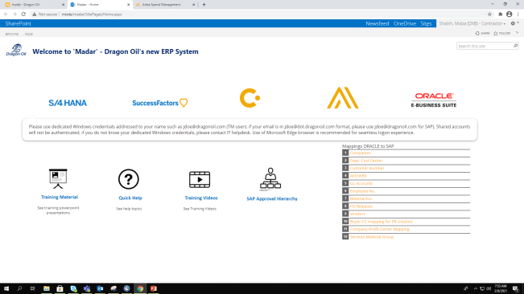
Open Ariba Spend Management from Madar.

Slide 3
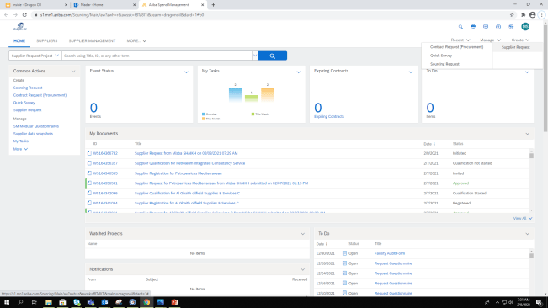
On the top right hand side corner under Create Click on Supplier Request.

Slide 4
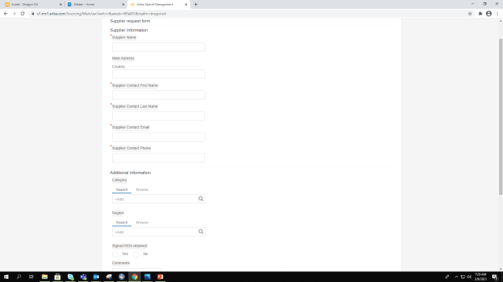
You will see the Supplier Request Form

Slide 5
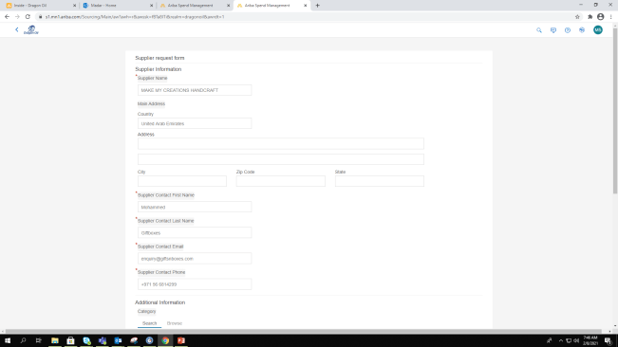
Fill up the details in the Supplier Request form. All mandatory fields must be filled.

Slide 6
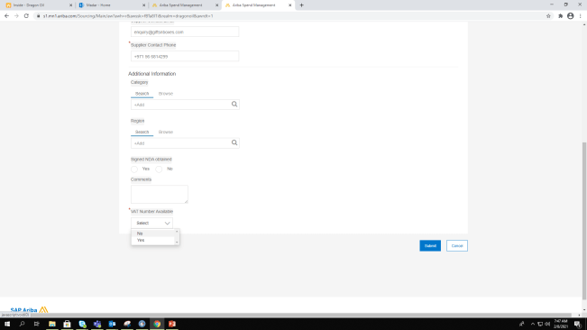
If you have VAT number select yes and enter number.

Slide 7
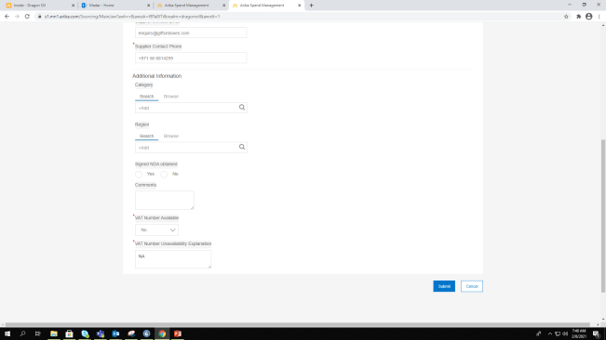
If not select No and fill in unavailability explanation.

Slide 8
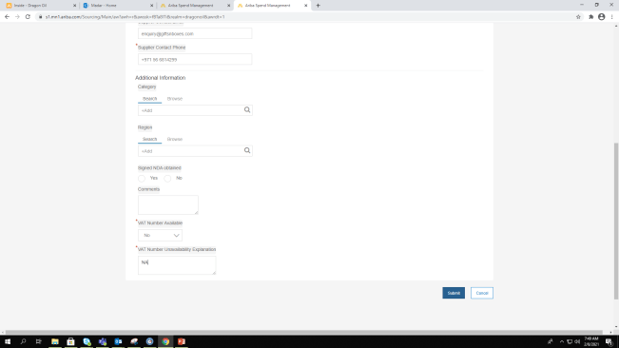
Review and submit form for approval.

Slide 9
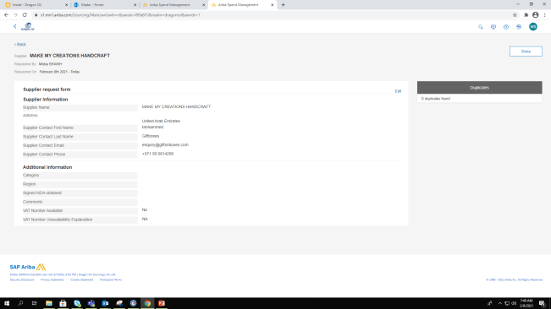
Your Supplier Request is created.

Slide 10
THANK YOU

